Slide 1
TSDS Upgrade Support Meeting ESC Region11 Friday, November 1st 9:00 AM

Slide 2
Agenda
Updates from TEA
AskTED
Fall PEIMS
TIMS Tickets
Known Issues
Software Updates
Helpful Resources
Questions or Comments

Slide 3
Updates from TEA
Fall Reports updated to include CSV:
PDM1-120-013 PK Student Roster
PDM1-121-006 Special Education Roster by Grade
PDM1-124-004 School Leaver Roster
DMC Level 2 Validations have been updated to include an option to Cancel validation jobs that are in “Scheduled” status.
Preloaded SA, SE, and SR Course Codes for PEIMS reporting (Staff Responsibilities)

Slide 4
Please have your LEA AskTED Administrator review and update incorrect data for the directories.
AskTED

Slide 5
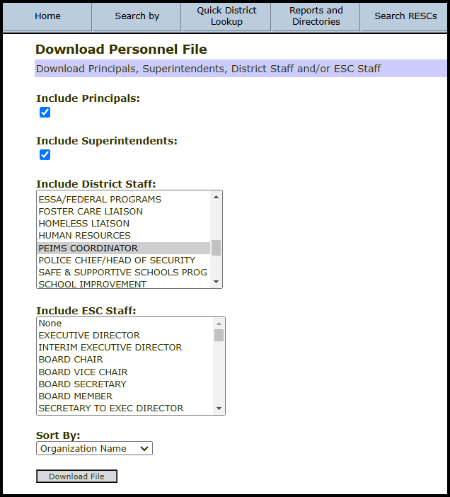
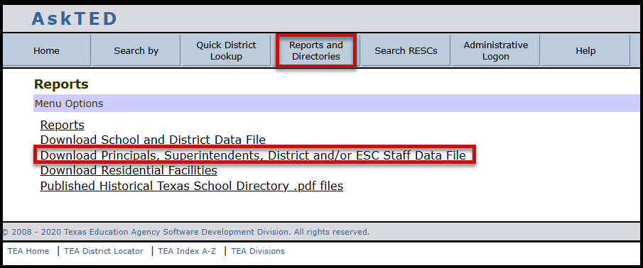
AskTED

Slide 6
Push for Fall PEIMS
TEA is requesting that all LEAs concentrate on Fall PEIMS and not on other PEIMS and Core Collections at this time. They are going to start monitoring Fall PEIMS progress and set a tentative timeline in which they are asking LEAs and ESCs to have completed specific tasks.

Slide 7
Fall PEIMS Timeline
Date | Metric | Target | Actual
November 4 | LEAs Publishing Some Data to IODS | All
November 11 | LEAs Publishing All 23 Entities | All
November 18 | LEAs Promoting All Entities | All
December 2 | LEAs Have Less Than 100 Fatals | All
December 5 | LEAs Completed Fall Submission | All

Slide 8
Steps to Success

Slide 9
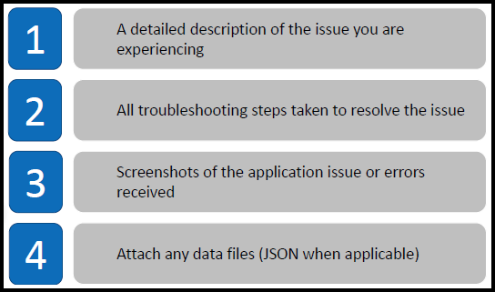
TIMS Tickets

Slide 10
New Known Issues
Fatal 40100-0142 – EB Parent Permission Code not pulling on students that withdrew before Fall Snapshot Date. Fix will be deployed this weekend.
Fatal 30050-000C – Staff Number of Days and Percent Day Employed not pulling. TEA is working on a fix. Release date TBD.
Fatal 40100-0139 – As-Of-Status for students in Grade Levels 8-12 is firing but not giving any identifying information to locate the students with the error. TEA is working on correcting this issue, but as a workaround LEAs can search for rule 40110-0001 and this rule will give you the student identifying information to assist in correcting the original fatal.

Slide 11
ASCENDER Software Updates
ASCENDER released a fix Thursday to correct the issue with the Special Ed Age field that was added to the sections in Grade Reporting. The fix was applied last night to our districts. LEAs will need to extract and send data again to remove the L1 errors.
ASCENDER is scheduled to release another update today that is supposed to fix issues on the business side. If released the update will be installed ……..

Slide 12
Other Software Updates
Please give us an update on your software vendors…….
Skyward – Next Update Scheduled for November 4th
Aeries – Next Update Scheduled for November 5th
PowerSchool – Next Update Scheduled for November 1st
eSchool – Next Update Scheduled for November 1st

Slide 13
Helpful Resources
TSDSKB-600 TSDS Known Issues https://tealprod.tea.state.tx.us/tims/browse/TSDSKB-600
TWEDS Upgrade
https://www.texasstudentdatasystem.org/tsds/teds/tweds-upgrade
Texas Education Exchange TSDS Assistance Center
https://txedexchange.net/tsds-assistance-center
TSDS Upgrade Project Resources (TEA)
https://www.texasstudentdatasystem.org/tsds/about/resources

Slide 14
Questions or Comments

